Slide 1
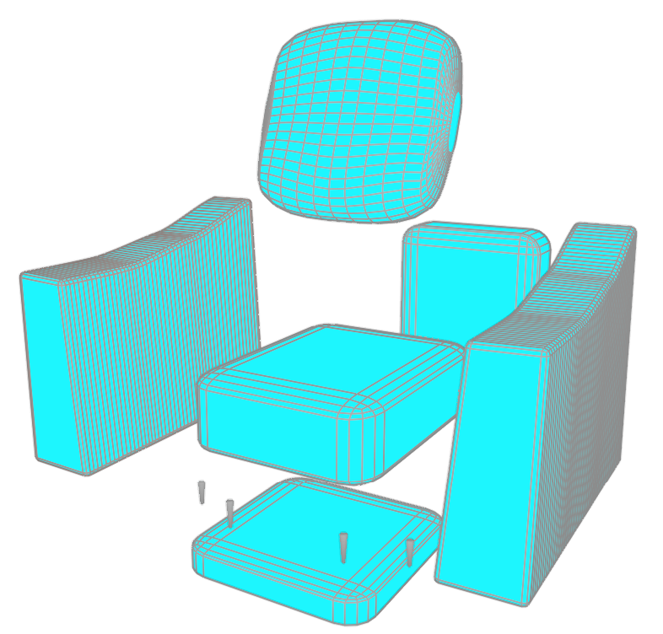
MeshCoder: LLM-Powered Structured Mesh Code Generation from Point Clouds
Bingquan Dai^{1,2*}, Li Ray Luo^{2*,} Qihong Tang^{1,3,} Jie Wang^{1,4}, Xinyu Lian¹, Hao Xu^{1,5}, Minghan Qin², Xudong Xu¹, Bo Dai¹, Haoqian Wang^{2†}, Zhaoyang Lyu^{1†}, Jiangmiao Pang¹
¹Shanghai AI Lab ²Tsinghua University ³Harbin Institute of Technology ⁴Beijing Institute of Technology ⁵HKUST(GZ)
MeshCoder: Generate and Reconstruct 3d shapes into structured codes

Slide 2
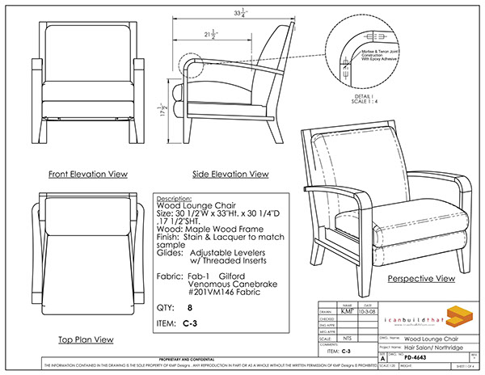
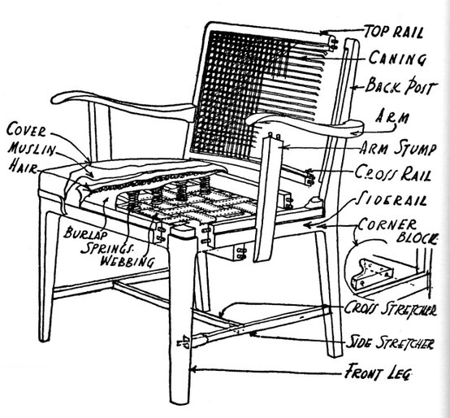
Motivating Problem
A nice sofa
The sofa with parametric details
How can we get parametric information from 3D shapes — and even make them editable?
reverse engineering

Slide 3
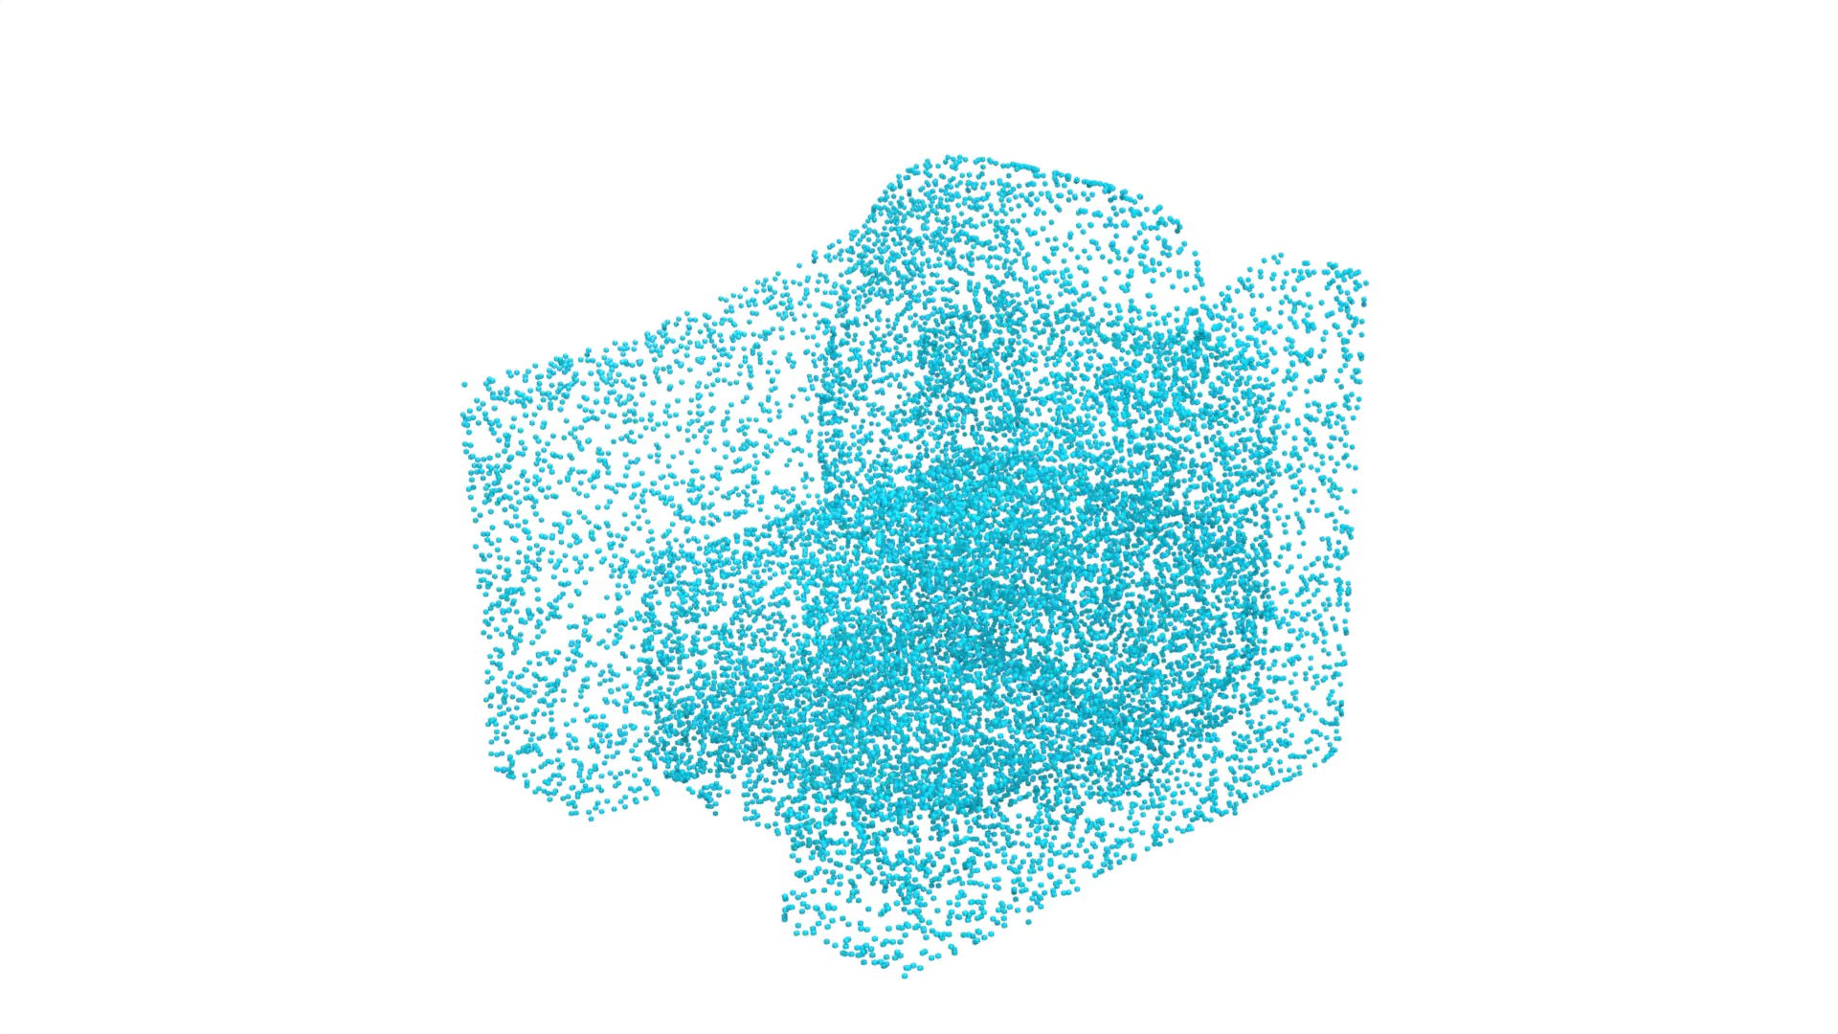
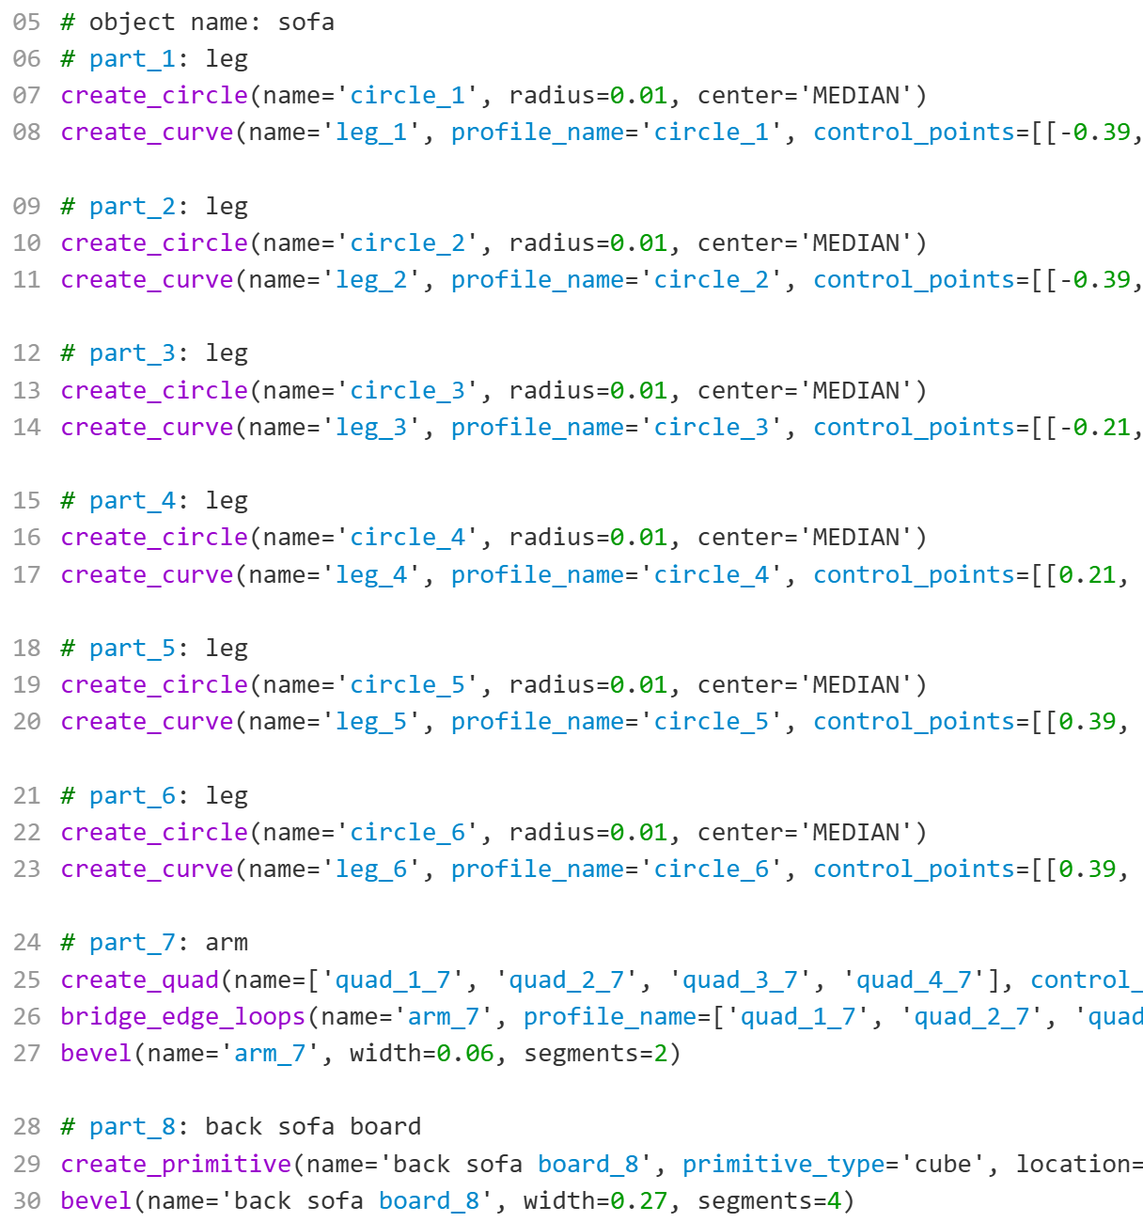
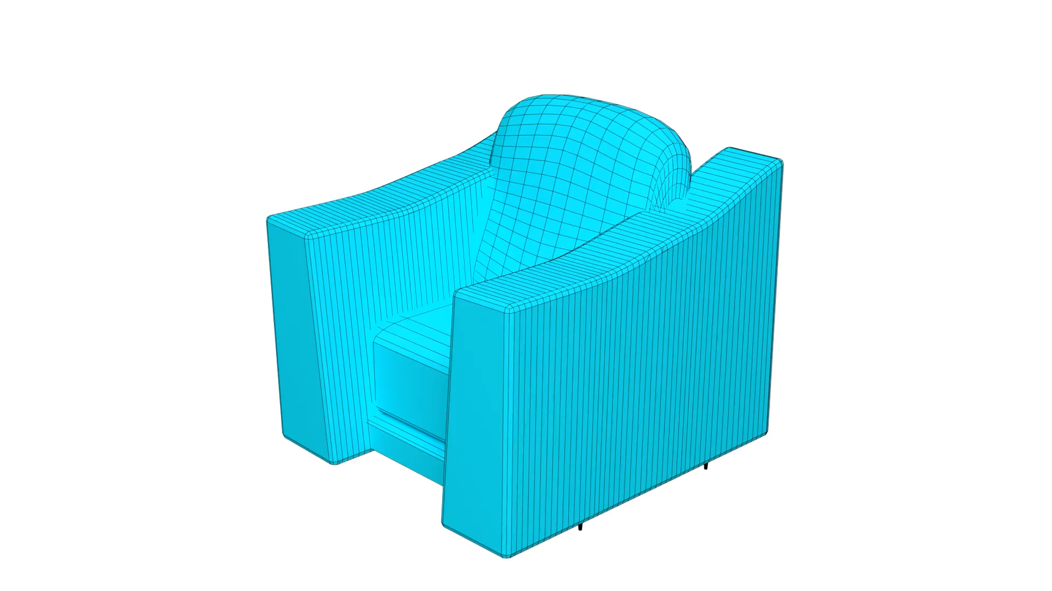
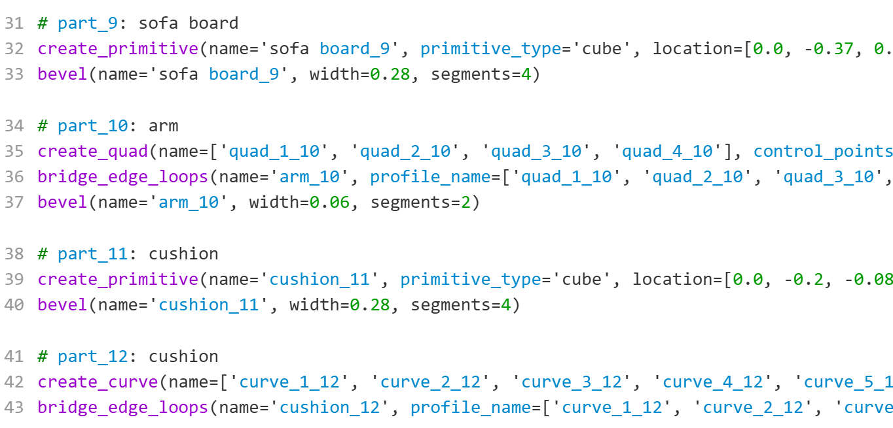
MeshCoder
Input: Point Cloud
⁝
Inference Model
Professional 3d software codes
Execute in Blender
Output: Structural Mesh

Slide 4
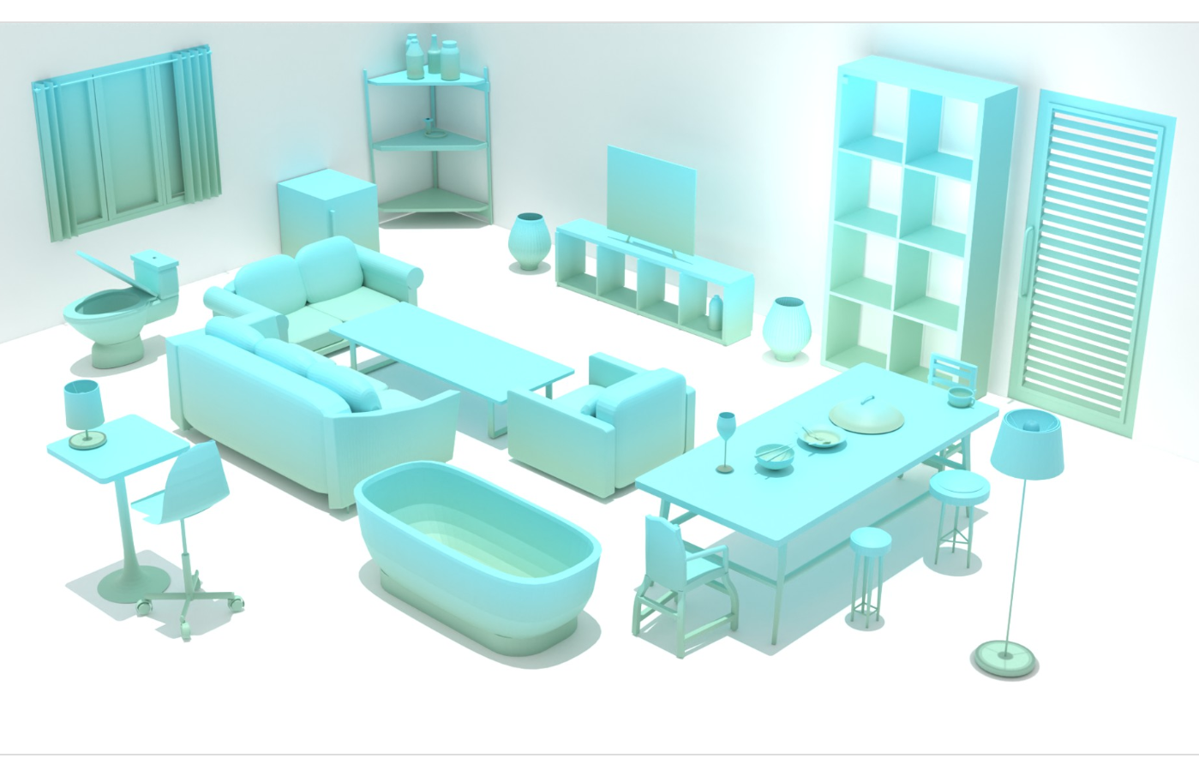
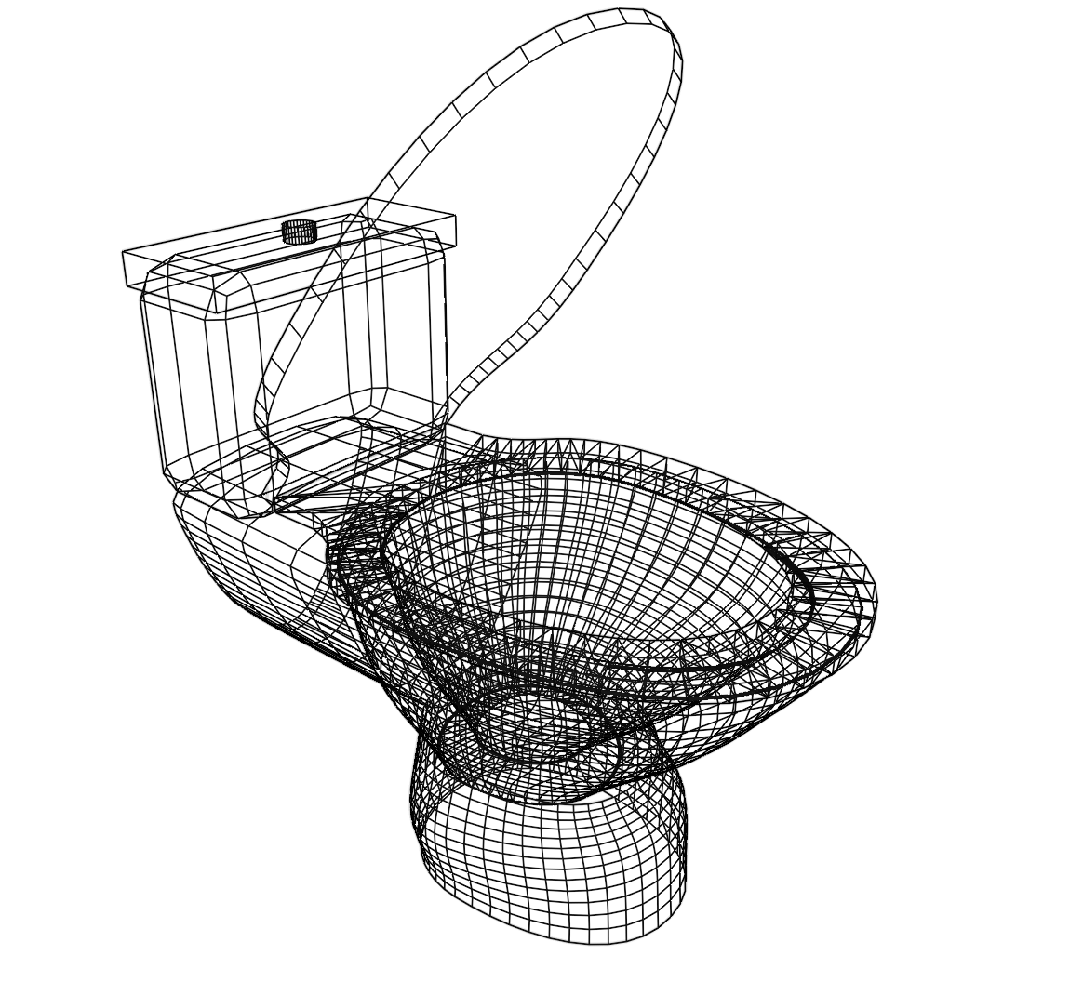
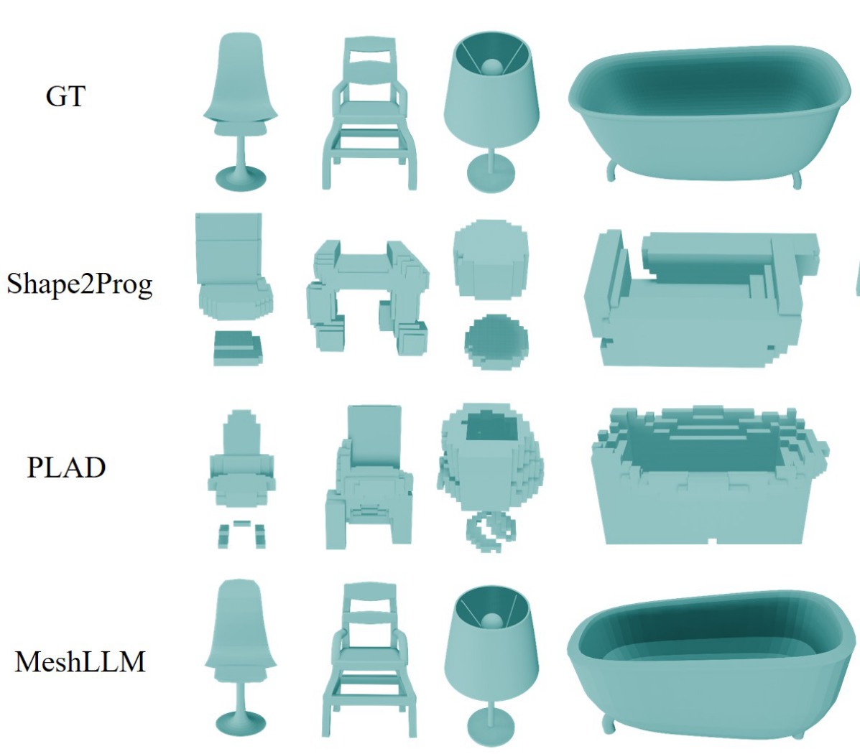
Our method achieves great performance
Category diversity
Topology quality
Reconstruction accuracy
Ours

Slide 5
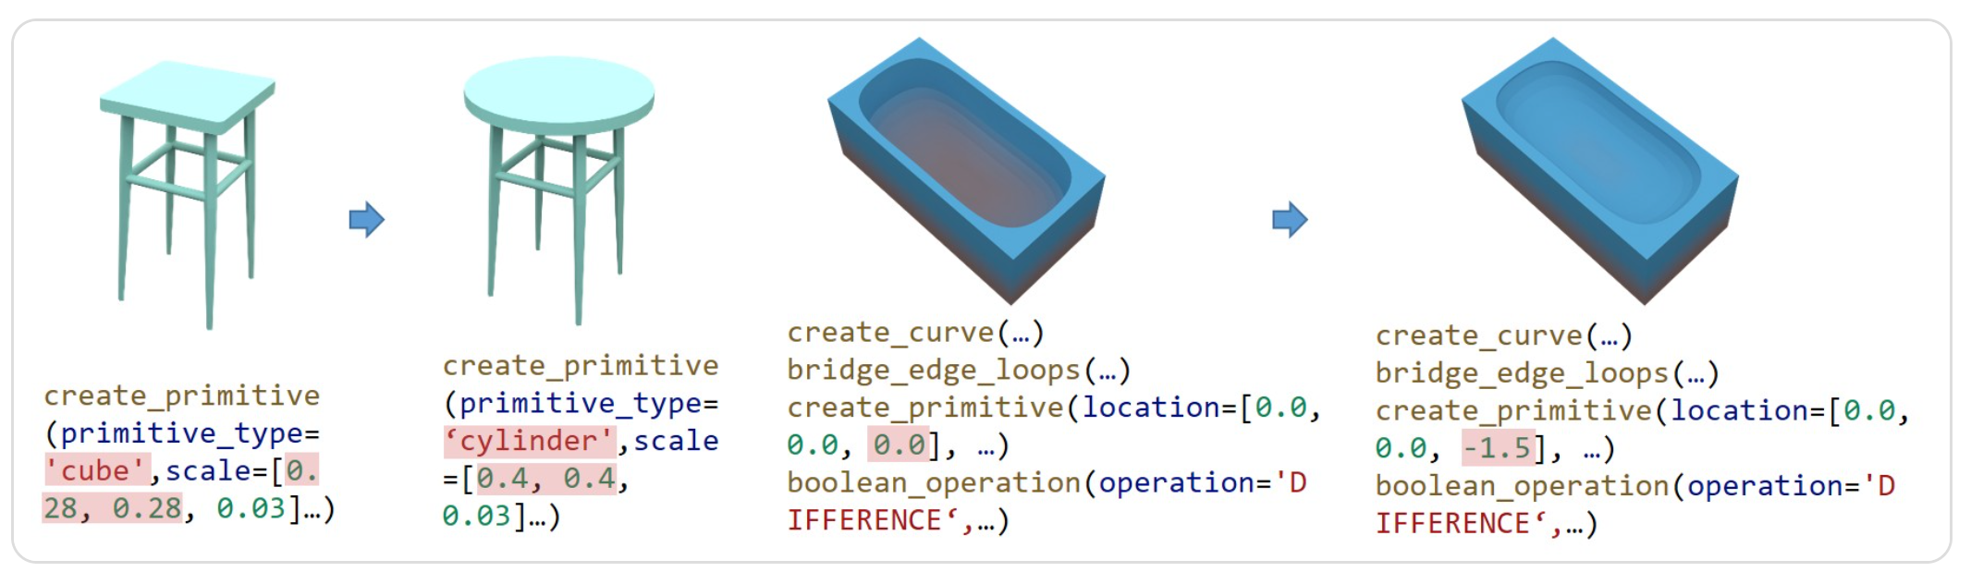
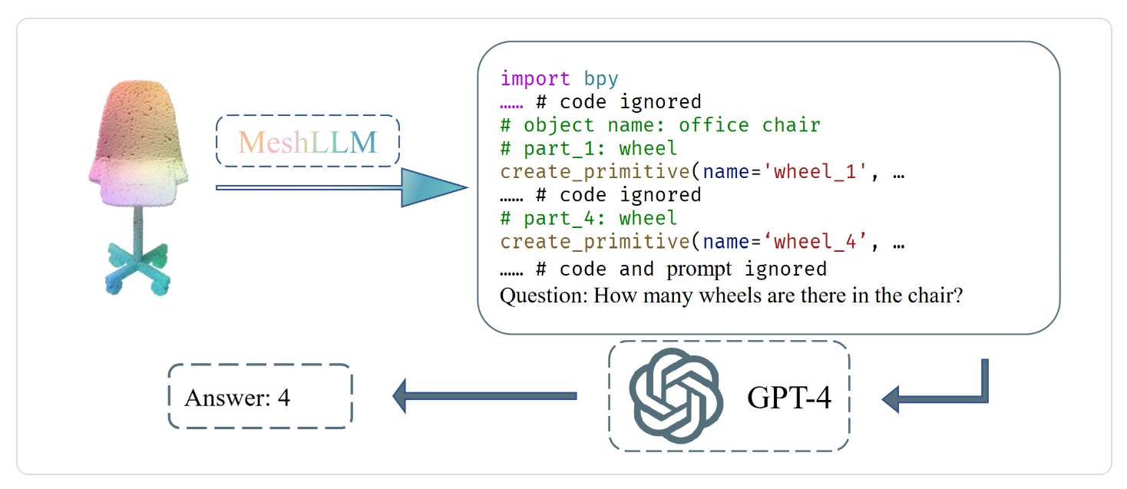
Unique features
Human editability
LLM understanding

Slide 6
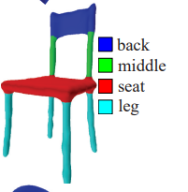
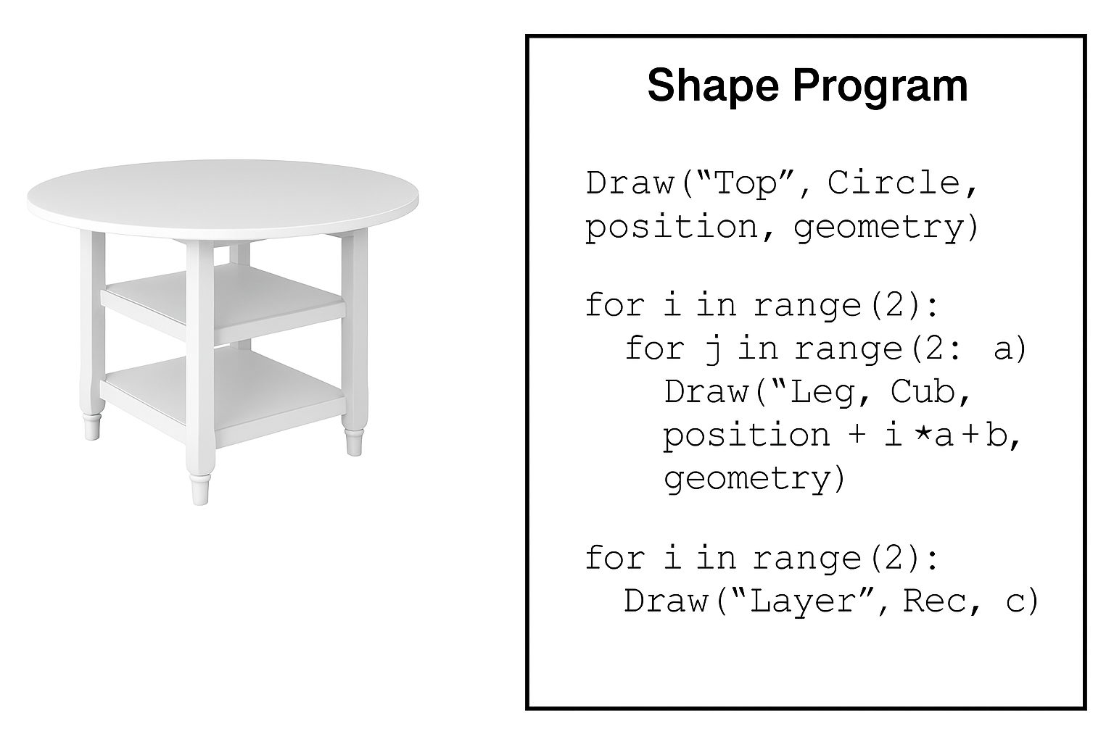
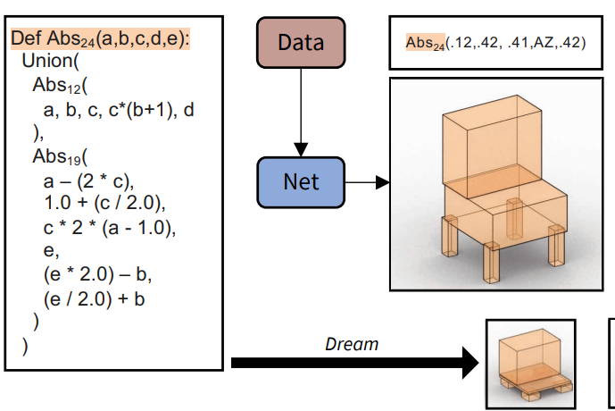
Existing Methods
3D Scanning + Mesh Segmentation
no parametric details & editability
[Evangelos et al, 2010]
Shape Program-based
shape logic only, no industrial-level usage
[Yonglong Tian et al, 2019]
[Kenny et al, 2023]

Slide 7
Step 1
Structural Shape Expression

Slide 8

Build our own DSL
Based on Blender API
Operation name
Pseudocode
Primitive
primitive(‘cube', loc=…, rot=…, scale=…)

Slide 9

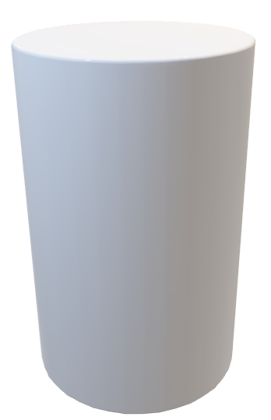
Build our own DSL
Based on Blender API
Operation name
Pseudocode
Primitive
primitive(‘cube', loc=…, rot=…, scale=…)
Sweep / Translation
sweep(profile='bezier', path='curve_spine', caps='both')

Slide 10
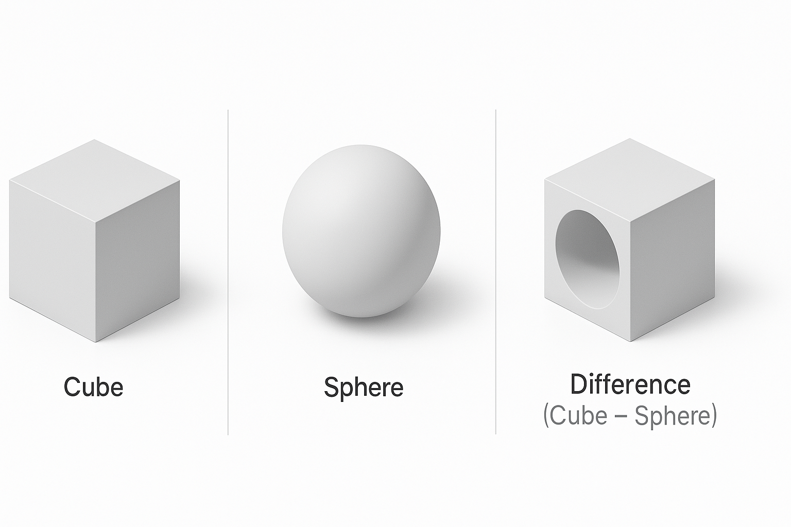
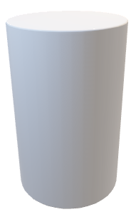

Build our own DSL
Based on Blender API
Operation name
Pseudocode
Primitive
primitive(‘cube', loc=…, rot=…, scale=…)
Sweep / Translation
sweep(profile='bezier', path='curve_spine', caps='both')
Boolean
boolean(A='cube', B='sphere', op='difference')
-
=

Slide 11
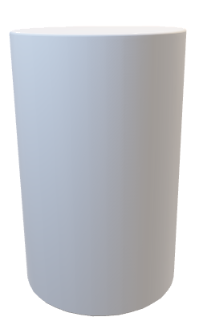
Build our own DSL
Based on Blender API
Operation name
Pseudocode
Primitive
primitive(‘cube', loc=…, rot=…, scale=…)
Sweep / Translation
sweep(profile='bezier', path='curve_spine', caps='both')
Boolean
boolean(A='cube', B='sphere', op='difference')
Loft / Bridge Loop
bridge_loops([c1,c2,c3], smooth=0.6)

Slide 12
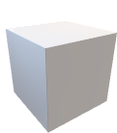

Build our own DSL
Based on Blender API
Operation name
Pseudocode
Primitive
primitive(‘cube', loc=…, rot=…, scale=…)
Sweep / Translation
sweep(profile='bezier', path='curve_spine', caps='both')
Boolean
boolean(A='cube', B='sphere', op='difference')
Loft / Bridge Loop
bridge_loops([c1,c2,c3], smooth=0.6)
Array
array('cube', type='grid', counts=(4,4), step=(0.2,0.2))
…

Slide 13
Build our own DSL
Based on Blender API
Operation name
Pseudocode
Primitive
primitive(‘cube', loc=…, rot=…, scale=…)
Sweep / Translation
sweep(profile='bezier', path='curve_spine', caps='both')
Five types of code blocks to express almost every 3d object.
Boolean
boolean(A='cube', B='sphere', op='difference')
Loft / Bridge Loop
bridge_loops([c1,c2,c3], smooth=0.6)
Array
array('cube', type='grid', counts=(4,4), step=(0.2,0.2))

Slide 14
Dataset Construction
Step 2

Slide 15
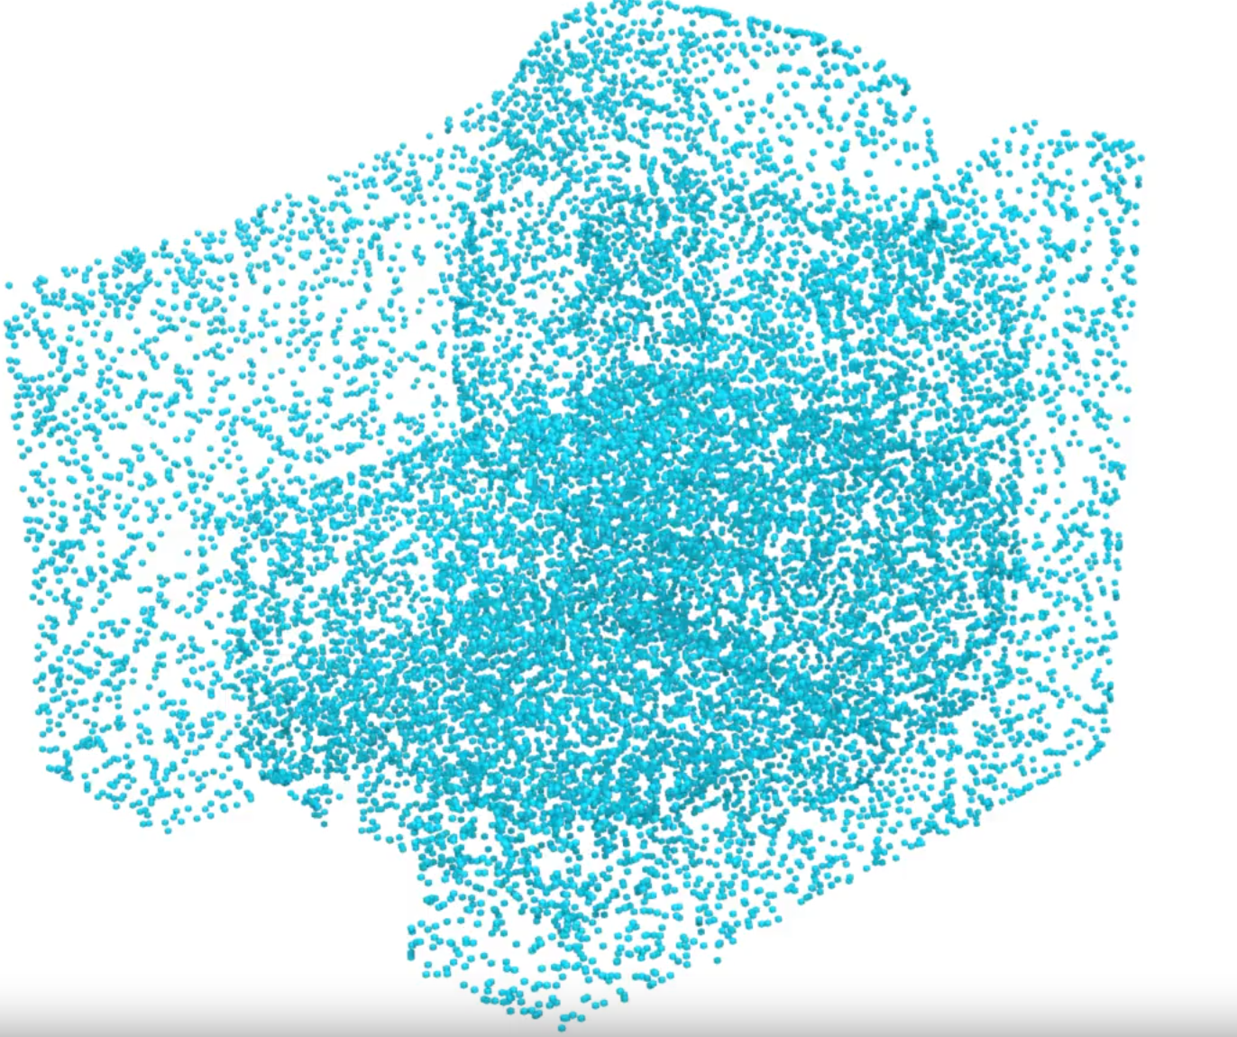
Basic Idea
Aim: Construct an (object point cloud, code) dataset for the inference model to learn from.
(
,
)
Structural, part by
part
Step 2: Train a part-level inference model

Slide 16
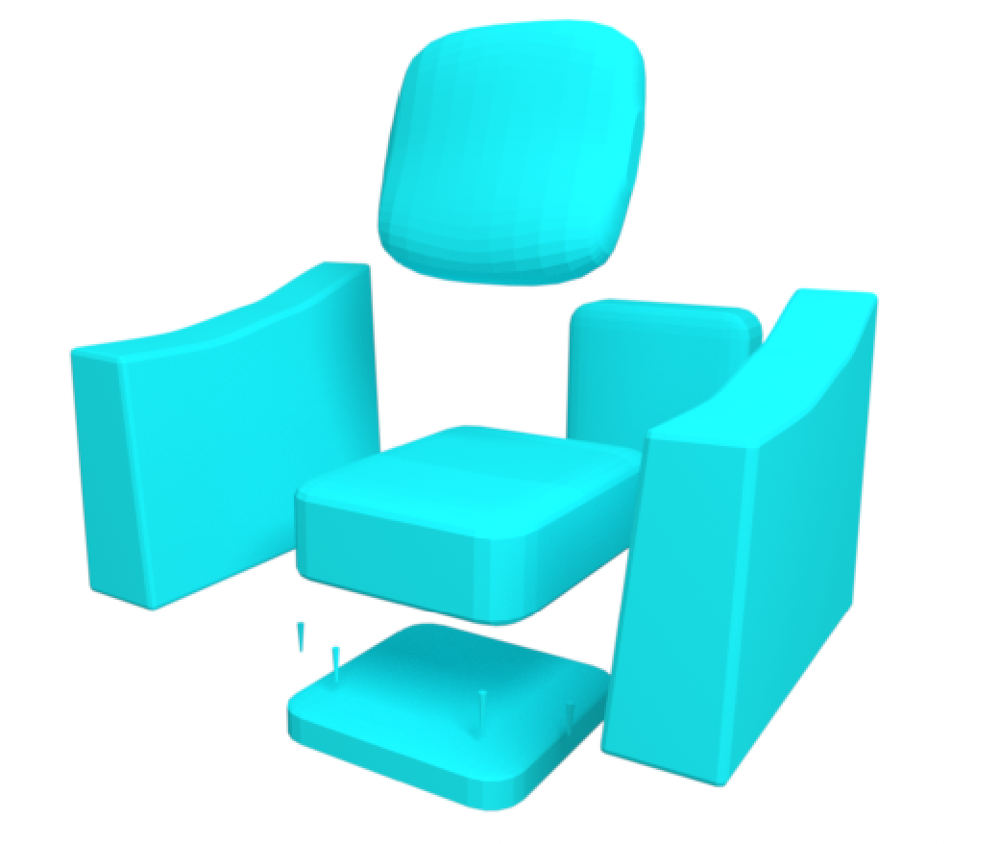
Basic Idea
Part-level
Code generation Programs
Part level Blender codes
(
,
)
(point cloud, blender codes)
pattern data
Train a part-level
inference model
……
Blender
……
……
Step 1: Write probabilistic programs to generate blender codes -> execute them to get 3d shape -> build the part-level dataset and train
Step 2: Train a part-level inference model

Slide 17
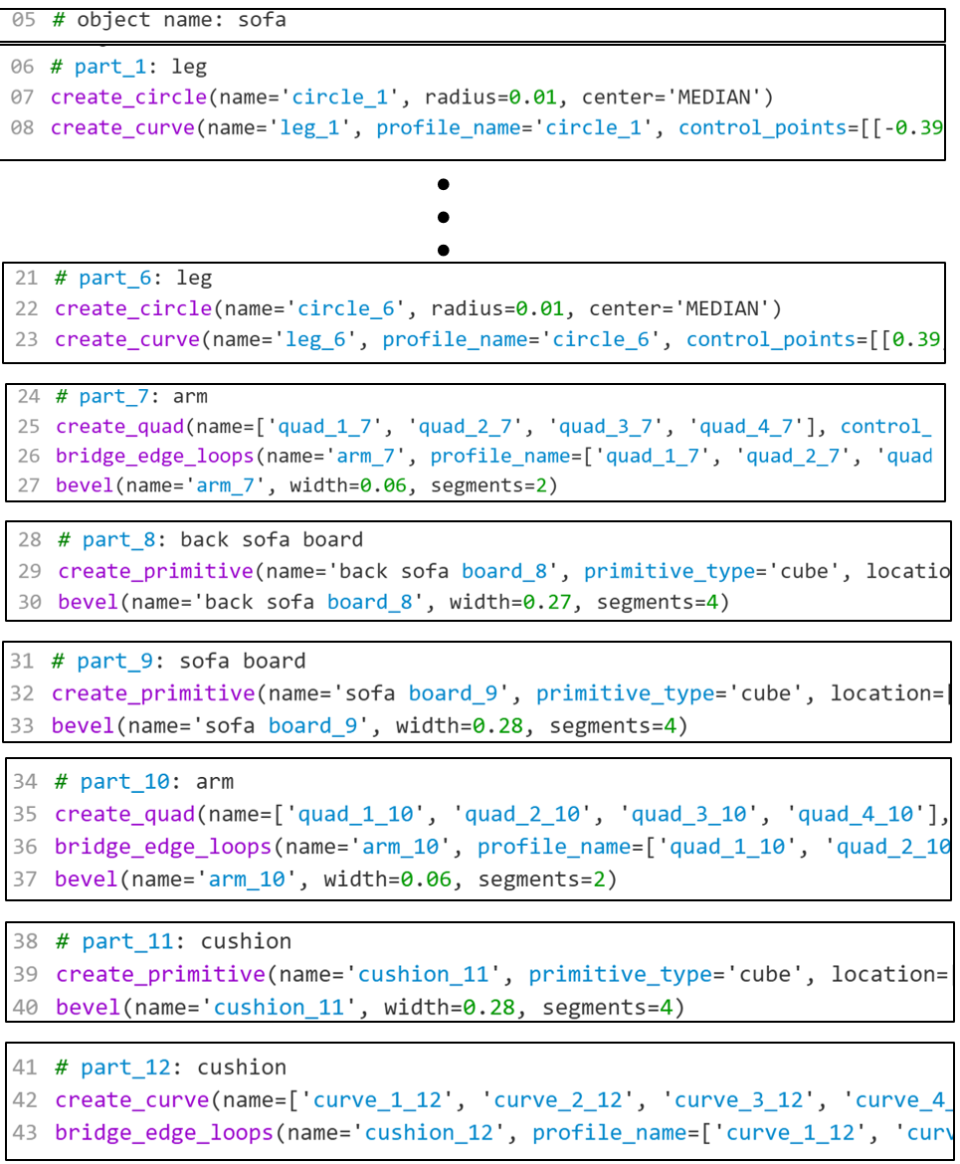
Basic Idea
Object-level
……
……
Now, we get the (point cloud, object ) pattern data, and can train the object-level inference model
Step 1: Write probabilistic programs to generate blender codes -> execute them to get 3d shape -> build the part-level dataset and train
Step 2: Train a part-level inference model

Slide 18
Inference Model Overview
Step 3

Slide 19
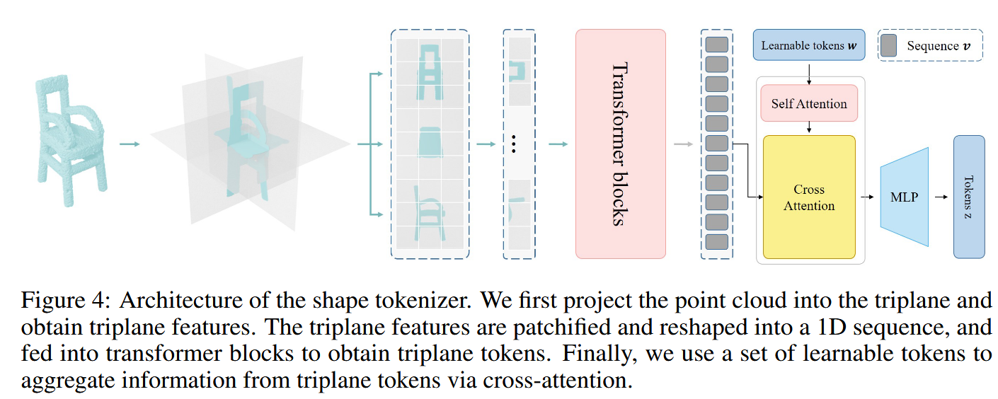
Model
shape tokenizer
code generation model
MeshCoder consists of two components: a shape tokenizer and a code generation model.” “We use a triplane-based tokenizer to project point clouds into compact representations.

Slide 20
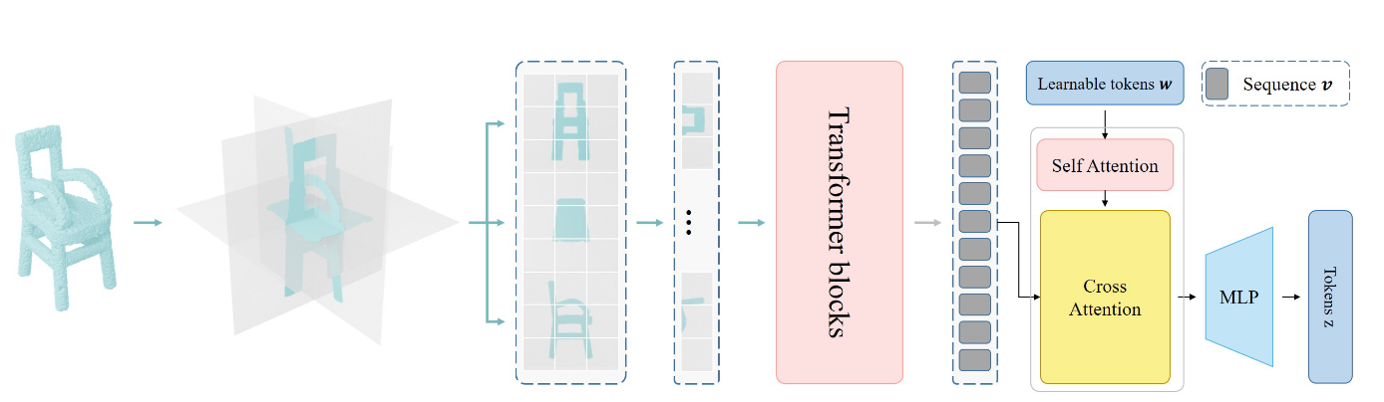
Model
shape tokenizer
Patchify and flatten
Learnable tokens with cross-attention
Projection to triplanes
Transformer blocks
MeshCoder consists of two components: a shape tokenizer and a code generation model.” “We use a triplane-based tokenizer to project point clouds into compact representations.

Slide 21
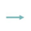
Model
code generation model
Finetuned LLM
Llama-3.2-1B with LoRA finetuning
MeshCoder consists of two components: a shape tokenizer and a code generation model.” “We use a triplane-based tokenizer to project point clouds into compact representations.

Slide 22
Contributions
Expressive Blender API Library
Embedded DSL for procedural modeling (primitives, patterns, sweeps, lofts).
Large-Scale Dataset Pipeline
Synthesized 10M+ part & 1M object point cloud–code pairs.
Shape-to-Code Inference Model
Encoder (shape tokenizer) + decoder (finetuned LLM) → executable code, enabling reconstruction, editing, and reasoning.

Slide 23
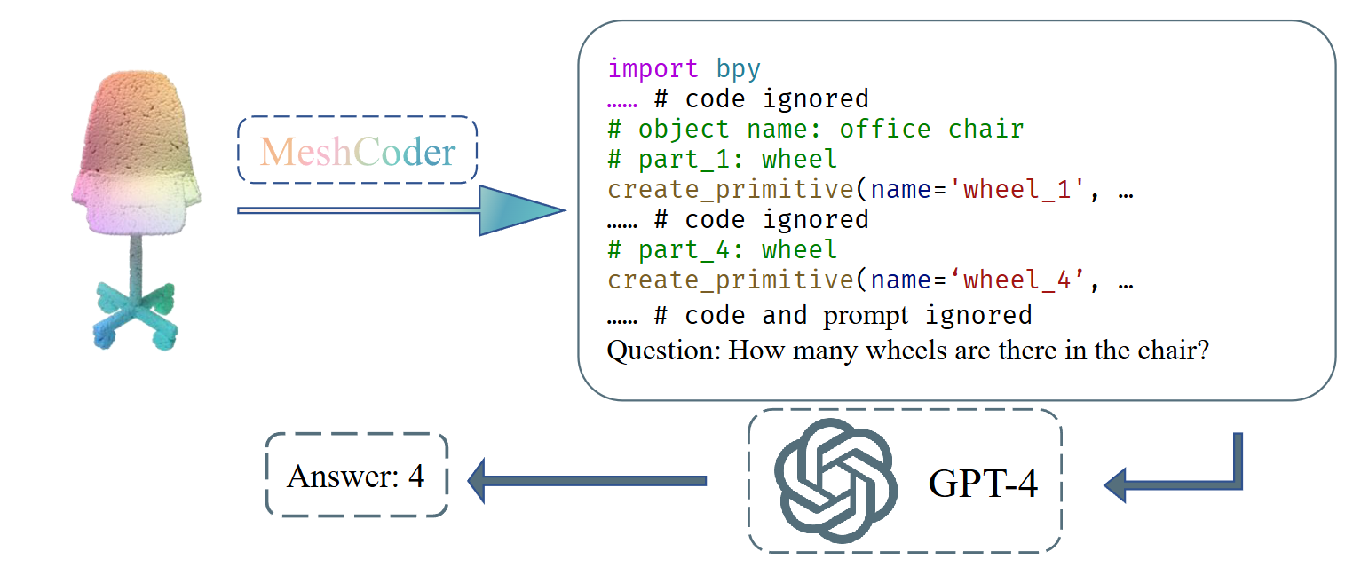
Code-Based Editing
Contributions
A new representation paradigm: one that makes 3D shapes editable, interpretable, and semantically meaningful — all thanks to code.”
Semantic Reasoning

Slide 24
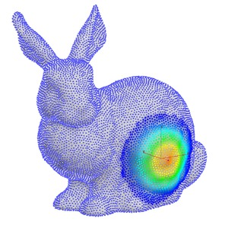
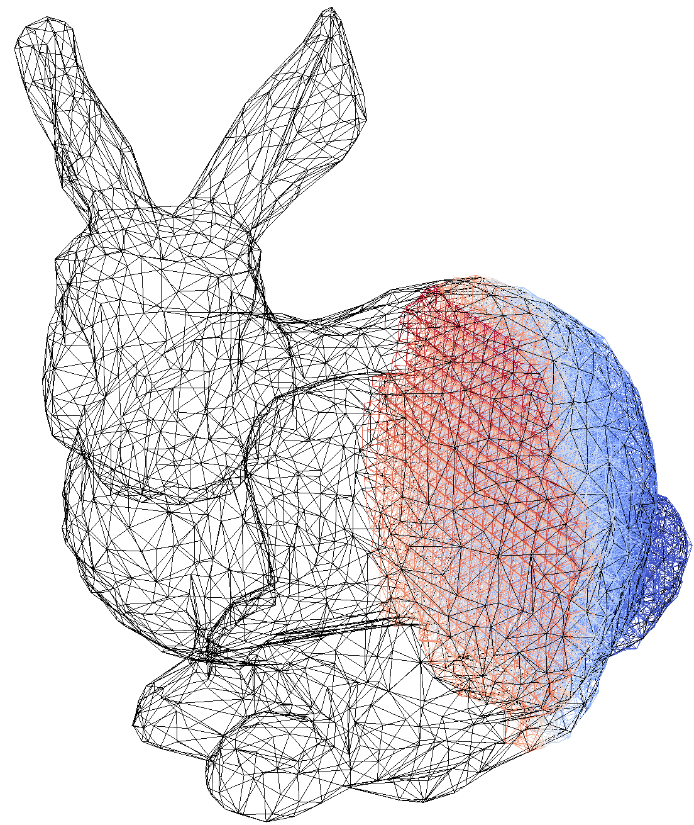
Challenge
废稿
: Structural Symbolic Shape Expression
Point Cloud
Simple Shape Program
Mesh
[Tian, Y. 2019] (1)
Low Level Patterns
shape logic only, no industrial-level usage
(1): Tian, Y: Learning to infer and execute 3d shape programs. 2019

Slide 25
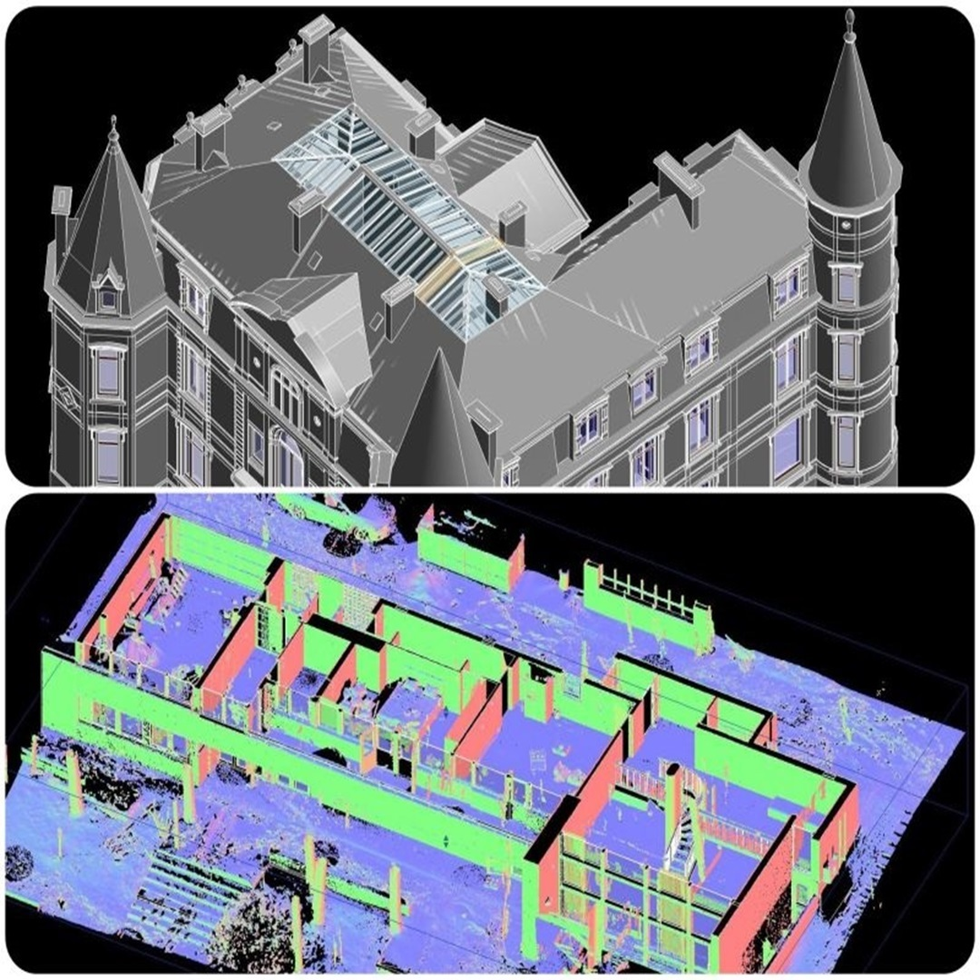

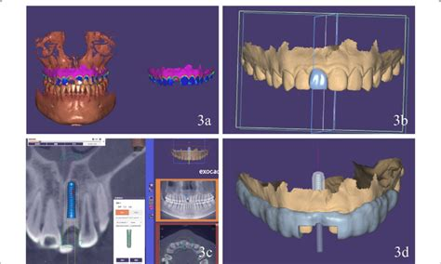
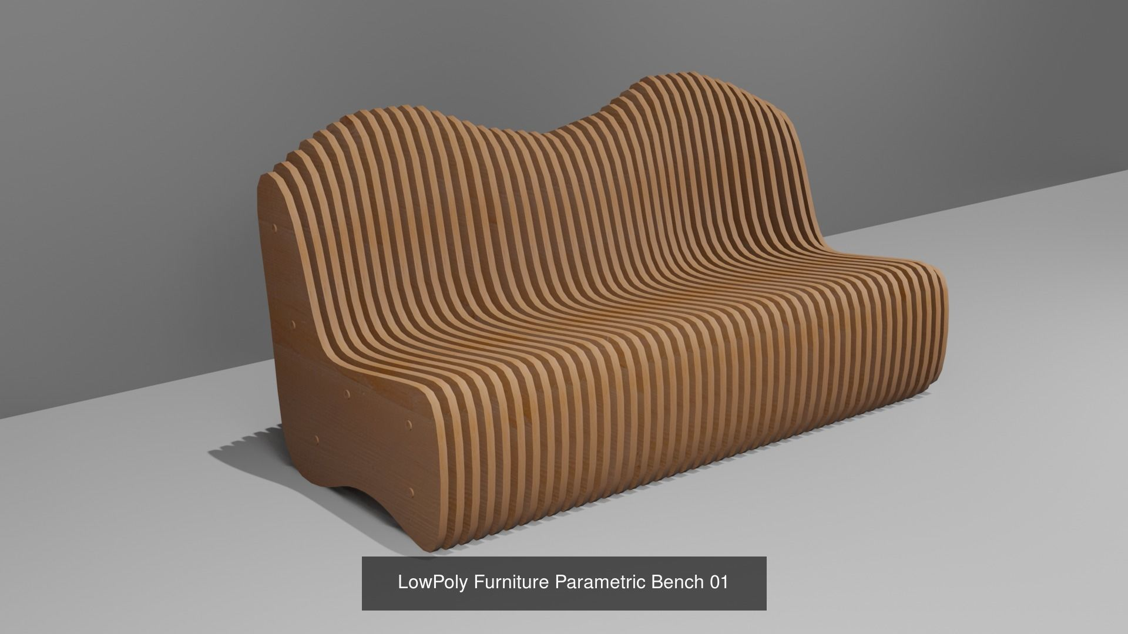
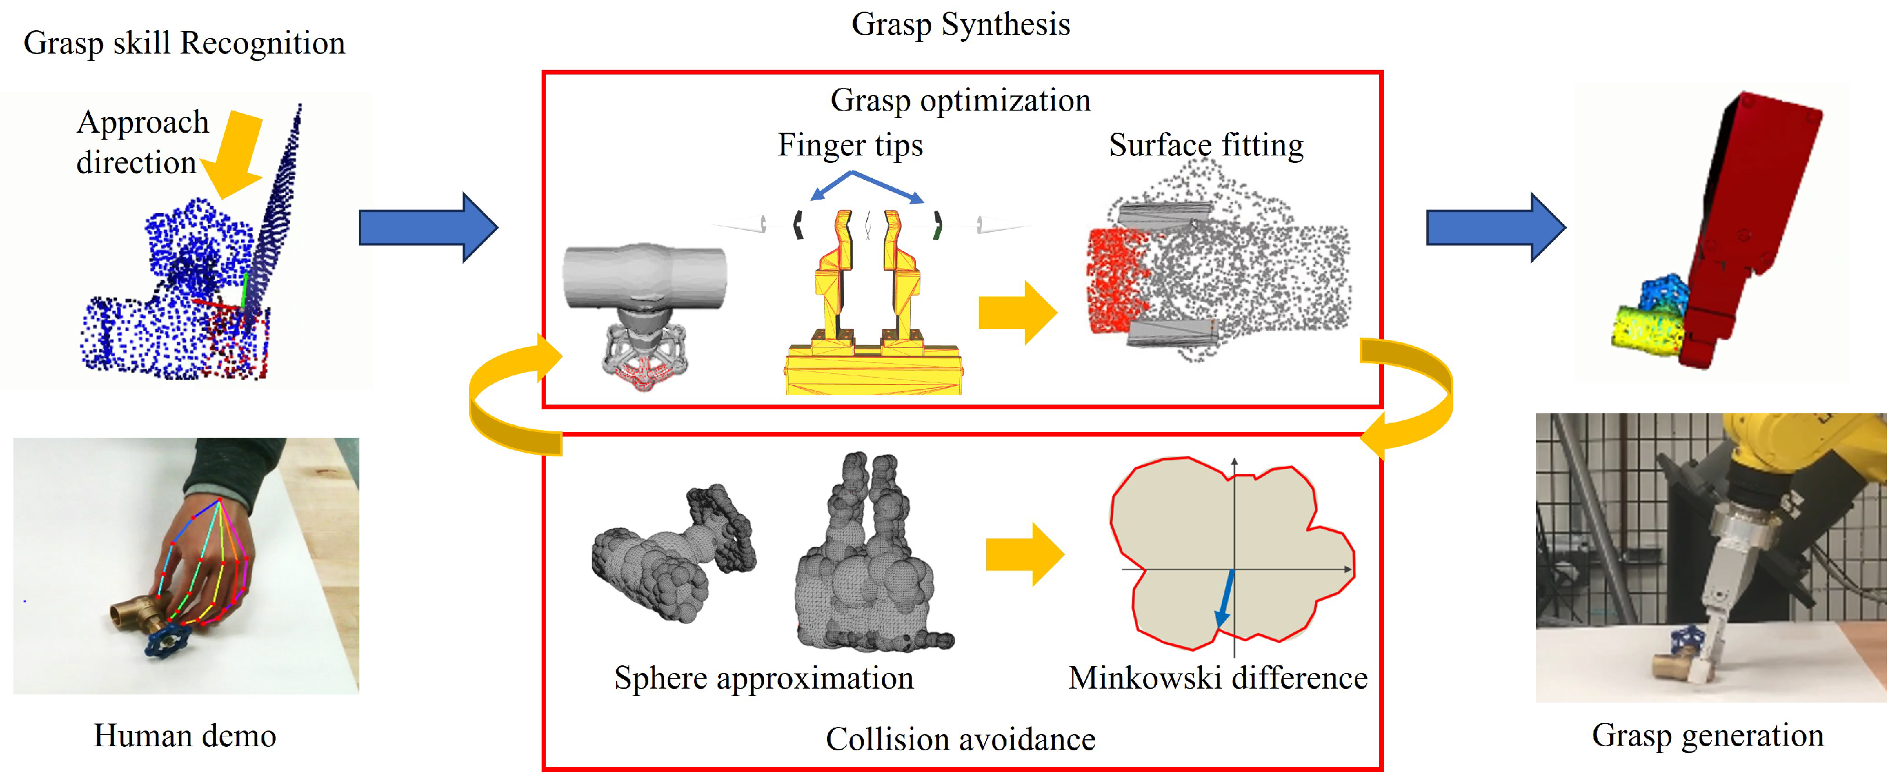
Cultural Heritage
Generating & Reconstructing complex 3D shapes is important in many fields
Architecture Analysis
Medical Implants
Furniture Design
Robotics & Simulation

Slide 26
Conclusion & Future work
So to sum up: MeshCoder combines a large part-based dataset, a Blender API, and a multimodal LLM to reconstruct and understand 3D shapes as code.” “It supports editing, reasoning, and better generalization than former basic DSL-based systems.” “We’re excited to extend this to organic shapes and explore interactive editing in the future.”

